Slide 1
Psychedelics and their therapeutic potentials in PTSD treatment
Eric Graack

Slide 2
Post Traumatic Stress Disorder (PTSD)
Debilitating anxiety condition lasting at least one month that manifests after directly or indirectly experiencing a traumatic event
Traumatic events can include:
physical or sexual assault
injury
combat-related trauma
natural disaster or death
https://www.fireengineering.com/articles/2016/01/im-a-firefighter-with-ptsd-now-what.html

Slide 3
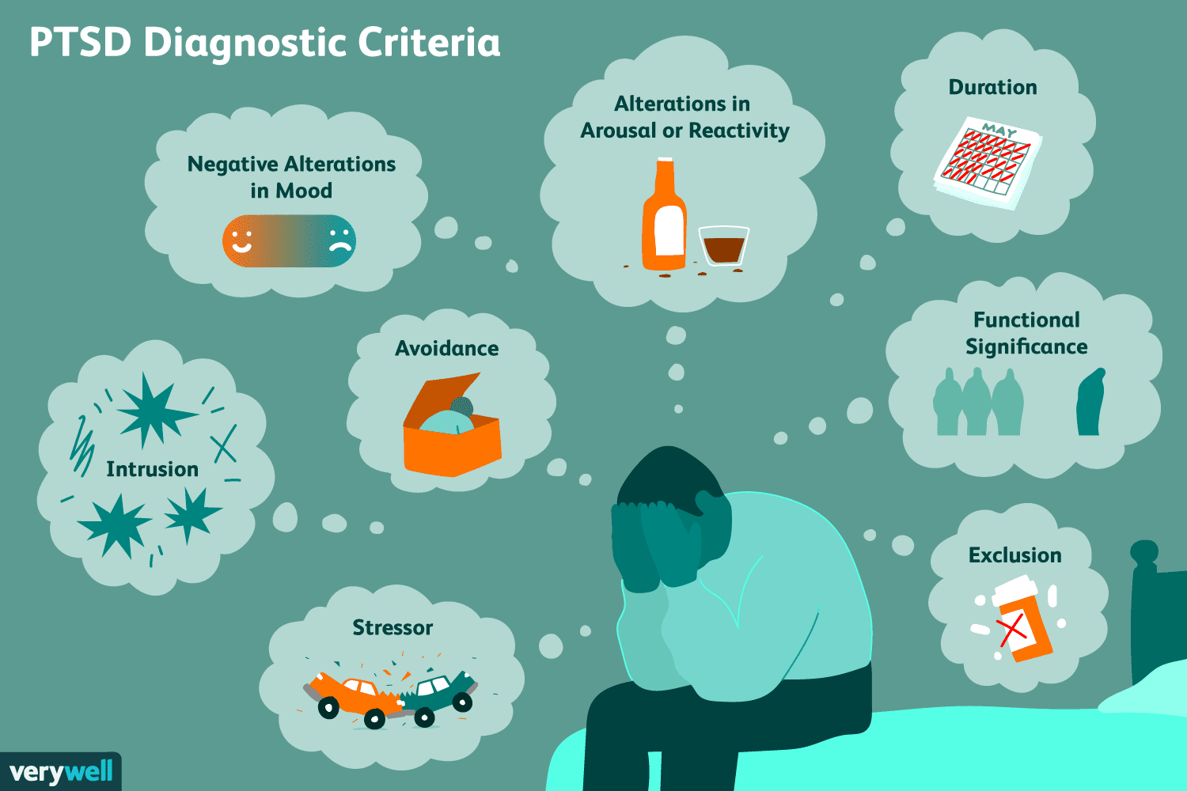
Symptomology
re-experiencing the traumatic event
avoidance of reminders of the traumatic event
sleep disorders/nightmares
intrusive/disturbing thoughts
negative changes in mood and cognitions
hyperarousal
often comorbid w/ mTBI, depression, anxiety, substance abuse and/or schizophrenia
https://www.verywellmind.com/requirements-for-ptsd-diagnosis-2797637
Notes:
Most cases involve comorbidities, often 3 or more

Slide 4
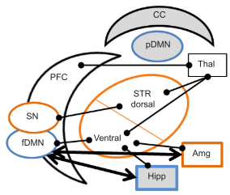
Brain networks implicated
Amygdala
Hippocampus
Decreased dentate gyrus and CA3 volume in PTSD populations
Prefrontal cortex
Anterior and posterior cingulate cortex
Thalamus
Insula
Claustrum
Striatum
Herrold (2014)
Notes:
Specifically lower hippocampus/DG
vmPFC and frontal default mode network (daydreaming, memories, planning, negative correlation w/ attention)

Slide 5
Current treatment options (limited)
Cognitive behavioral therapy (CBT) – most effective in acute PTSD (< 1 month)
Cognitive processing therapy (CPT) – re-exposure/cognitive restructuring
Repeated transcranial magnetic stimulation (rTMS) – for comorbidities
SSRIs with psychiatric therapy (psychopharmacotherapy) – long term
Yet a treatment resistant population still exists
Notes:
CBT – mindfulness and change your thinking type of therapy
CPT – has negative side effects: depression, anxiety, suicidal ideation
idea is training to learn previous trauma cue no longer predicts threat
rTMS non invasive; comorbidities include substance abuse mtbi depression anxiety
SSRIs and therapy – take awhile to have effect

Slide 6
Psychedelic Alternatives
Animal studies using administration of psychoactive drugs following induced trauma have shown promising behavioral improvements in attention, anxiety, memory, and fear extinction.
Few of these prospects have moved to clinical trials, and results are promising. Treatment resistant populations have shown improvements with controlled psychedelic drug therapy in tandem with psychotherapy.
Ketamine and MDMA specifically seem to be the psychedelic drug of choice in psychopharmacotherapy for treatment resistant individuals.
Notes:
Recall that ketamine is an NMDAR antagonist and MDMA is a GABA_{A}R antagonist

Slide 7
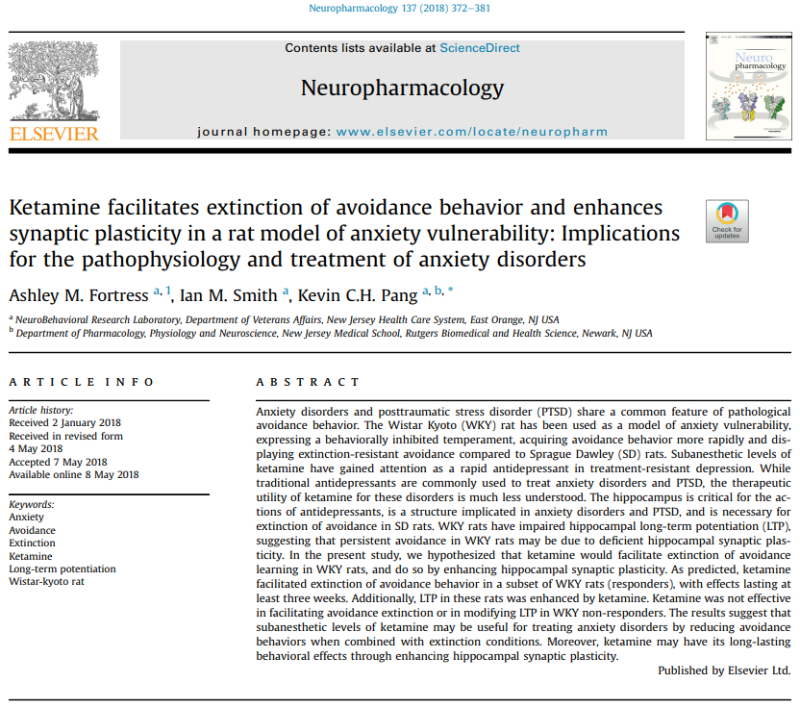

Slide 8
Background/Methods
SD and WKY rats – model avoidance/anxiety behavior
WKY rats more resistant to avoidance extinction compared to SD rats
models PTSD/antidepressant treatment resistant clinical population
Avoidance/acquisition phase (12 sessions)
Avoidance measured by lever press after sound
Escape measured by lever press after shock
Failure if lever not pushed after 20 shocks
Extinction phase (6 sessions)
Ketamine (NMDAR antagonist) or saline i.p. then extinction training (no foot shock or safety signal). Ketamine responder and non-responder groups determined
Extinction retest phase (1 session)
Drug free, 3 weeks after final extinction session, same conditions as extinction session
E-Phys 2 weeks following retest
Hippocampus area of interest – decreased LTP in anxiety conditions
Notes:
Wistar Kyoto WK Sprague Dawley SD

Slide 9
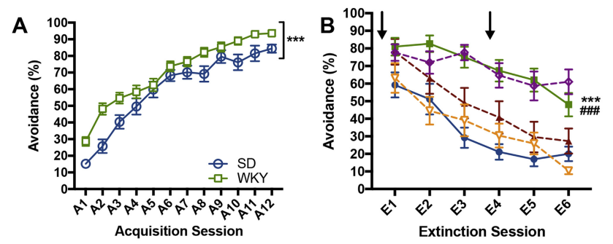
Figure 1
Notes:
12 acquisition sessions, p<.001 effect of strain, both groups learned avoidance though

Slide 10
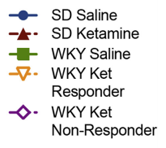
Figure 1
Notes:
*** p<.001 saline SD vs WKT
### p<.001 saline WKT vs WKT ketamine responders
Should learn there is nothing to fear, non responders and WKY saline don’t learn too well, WKY ketamine learned best?

Slide 11
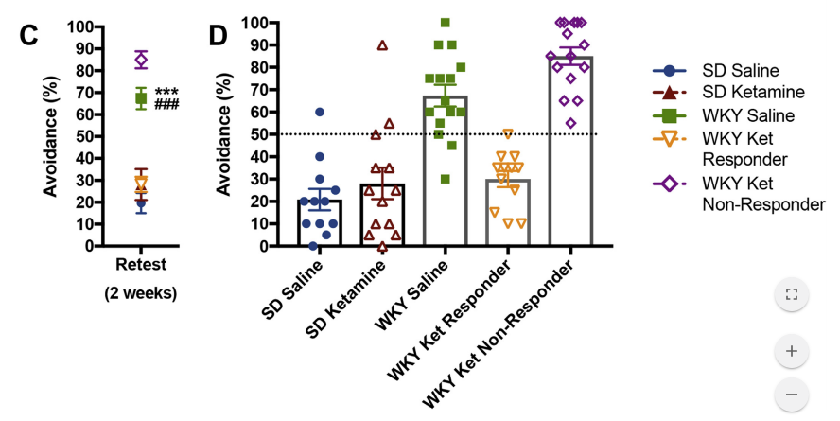
Figure 1
Notes:
*** p<.001 saline SD vs WKT
### p<.001 saline WKT vs WKT ketamine responders
WKY saline and ketamine non-responders avoid much more than SD saline, SD ketamine, and WKY ketamine responders.
Also note the fact that SD saline and ketamine are relatively the same, suggesting drug won’t affect mice and rats the same way and may act differently across species?

Slide 12
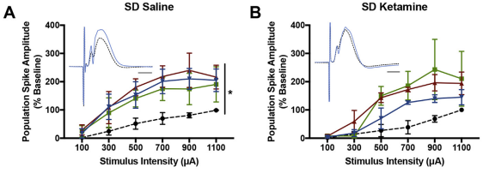
Figure 2
Notes:
LTP following HFS in the medial preforant pathway (mPP to DG) in SD saline and ketamine (next slide see WKY ketamine responders as well, but not in WKY saline and non-responders)
* p<.01 main effect of time

Slide 13
Figure 2
Notes:
LTP following HFS in the medial preforant pathway (mPP to DG) in WKY ketamine responders (like SD saline and ketamine) but not in WKY saline and non-responders
* p<.01 main effect of time

Slide 14
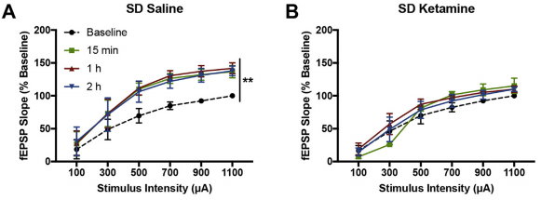
Figure 3
Notes:
Field excitatory post synaptic potential (fEPSP) LTP was not affected by ketamine. Although saline-treated SD rats demonstrated LTP following HFS (A), no other group demonstrated potentiation of the fEPSP. In (A), *p<0.05 represents main effect of time within group.

Slide 15
Figure 3
Notes:
Field excitatory post synaptic potential (fEPSP) LTP was not affected by ketamine. Although saline-treated SD rats demonstrated LTP following HFS (A), no other group demonstrated potentiation of the fEPSP. In (A), *p<0.05 represents main effect of time within group.

Slide 16
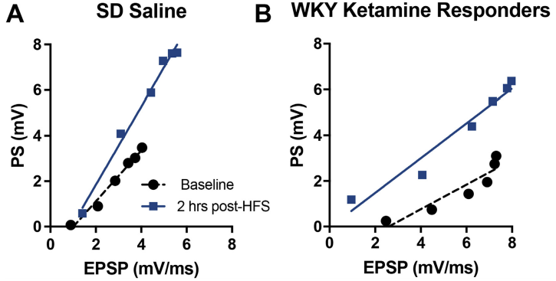
Figure 4
Notes:
Previous figures suggested EPSP-spike (E-S) coupling affected
Saline SD show increased excitability of granule cells, but saline SD E-S plot is different than baseline, while WKY ket responders slope is the same and no rightward shift, suggesting LTP is happening in a different fashion than seen in SD saline rats
HFS caused enhanced synaptic efficacy and increased excitation of granule cell in SD saline rats, whereas LTP in WKY ketamine responders was only characterized by an increase in granule cell excitability

Slide 17
Discussion/Take Away
Ketamine facilitates extinction of avoidance behavior in anxiety-vulnerable rats
This has been shown in humans as well
However, ketamine responder and non-responder populations exist
Antidepressant response due to ketamine metabolite HNK increasing GluA1, GluA2, & BDNF synthesis in Hipp, not PFC
Ketamine facilitated hippocampal LTP in WKY responder rats, humans too?
specifically affects the medial entorhinal cortex to dentate gyrus pathway through the medial perforant pathway
WKY and PTSD hippocampus have less inhibitory neurons, study GABA?
Notes:
(2S,6S; 2R, 6R)-hydroxynorketamine (HNK)

Slide 18
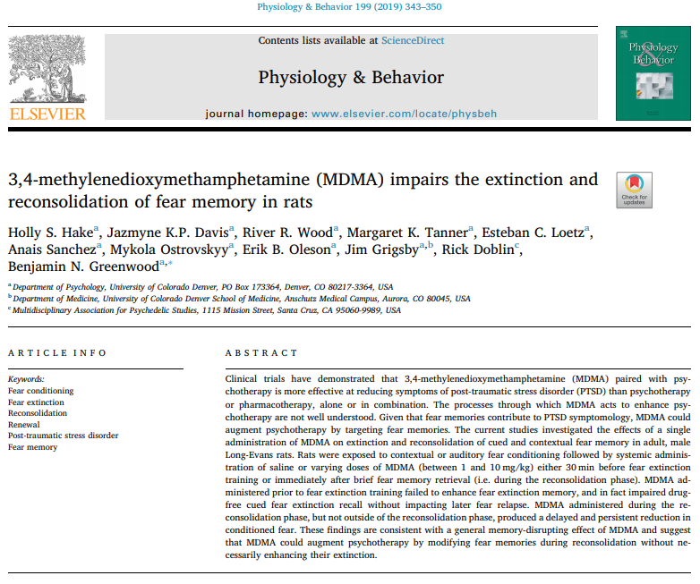

Slide 19
Methods/Background
Idea is to use MDMA during fear-extinction to cause memory reconsolidation
Want to see if adult male Long Evans rats respond the same as mice in previous lit.
Translates to PTSD better
Fear Conditioning
Context A 3 mins, then 10s auditory CS followed by foot shock US (4x)
Amount of freezing measured fear response
Fear Extinction & Memory
Both at 24 hrs and 7 days following conditioning, saline or MDMA administration 30 mins prior to training
Context B plus auditory CS followed by no foot shock US (20x)
Also reconditioned in Context A for 15 mins for contextual fear extinction
Fear Renewal
Context B or Context C for 3 mins then auditory CS followed by foot shock US (20x)
Memory reactivation and reconsolidation
Both at 24 hrs and 7 days following conditioning, saline or MDMA administered after Context B re-exposure
Context B for 3 mins the single auditory CS
Notes:
Fear Extinction – learning the previous-trauma cue no longer presents threat, but patients relapse, so prevent this with reconsolidation using MDMA
Find out later that contradicting results regarding BDNF levels following administration of MDMA in rats and mice that goes unexplained. Molecularly there is something interesting happening regardless in the amygdala & hippocampus
3 & 5 mg/kg dose reasons end of section 2.2 drugs

Slide 20
Figure 1
Notes:
Experimental timeline – associate auditory tone means foot shock is coming, then see if tone and shock cause same reaction in different context
Fear Conditioning
Context A 3 mins, then 10s auditory CS followed by foot shock US (4x)
Amount of freezing measured fear response
Fear Extinction & Memory
Both at 24 hrs and 7 days following conditioning, saline or MDMA administration 30 mins prior to training
Context B plus auditory CS followed by no foot shock US (20x)
Also reconditioned in Context A for 15 mins for contextual fear extinction

Slide 21
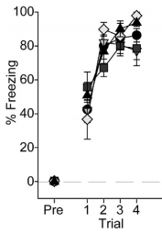
Figure 1
Notes:
Received MDMA or saline 30 mins prior to conditioning, all groups conditioned

Slide 22
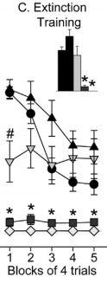
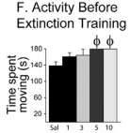
Figure 1
Notes:
C) 5 and 10 mg MDMA freeze significantly less than saline, 1, or 3 mg MDMA
F) 5 and 10 mg MDMA explored more prior to extinction training as well
* p < 0.05 relative to all other groups except each other;
# p < 0.05 relative to all other groups

Slide 23
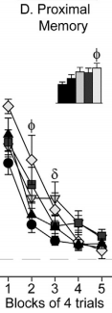
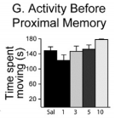
Figure 1
Notes:
D) 24 hr MDMA causes increased freezing…odd…that isn’t good…
G) No difference in time spent movine before proximal memory test
Φ p < 0.05 10 mg/kg MDMA versus Saline;
δ p < 0.05 3 mg/kg MDMA versus Saline.

Slide 24
Figure 1
Notes:
E) 7 day no difference. Good, PTSD patients have fear extinction problems 1 month plus out following trauma exposure, still odd about the 1 day proximal though?

Slide 25
Figure 2
Notes:
Experimental timeline – associate auditory tone with foot shock in context A, then administer drug and associate tone with shock in context B, then wait and see if context and/or tone is remembered by testing in context B or C
Fear Renewal
Saline or 3 mg MDMA 30 mins prior to fear renewal
Context B or Context C for 3 mins then auditory CS followed by foot shock US (20x)

Slide 26
Figure 2
Notes:
B) Each group froze the same regardless of context in fear conditioning

Slide 27
Figure 2
Notes:
C) Levels of freezing during fear extinction; MDMA decreases, increases, then decreases freezing
*p < 0.05 3 mg/kg MDMA/Context B relative to Saline/Context B

Slide 28
Figure 2
Notes:
D) Levels of freezing during fear renewal test. *p < 0.05 3 mg/kg MDMA/Context B relative to Saline/Context B
Overall it seems prior MDMA increases freezing in repeated context, and prior saline increases freezing in new context…how do we interpret this???

Slide 29
Figure 3
Notes:
Experimental timeline – associate context with foot shock but no tone, stay in same context throughout
Fear Extinction & Memory
Context A and foot shock (US) without auditory stimulus (CS)
Wait 24 hr, administer saline or MDMA, test contextual fear extinction at 30 mins and 24 hrs after

Slide 30
Figure 3
Notes:
B) Levels of freezing during contextual fear conditioning; all rats condition the same

Slide 31
Figure 3
Notes:
C) Levels of freezing during contextual fear extinction; saline group froze more than MDMA treated group (saline remembered context A means shock)
* p < 0.05 relative to all other groups;
# p < 0.05 Saline relative to 5 mg/kg MDMA

Slide 32
Figure 3
Notes:
D) Levels of freezing during the contextual fear extinction memory test; all groups froze the same at 24 hrs

Slide 33
Figure 4
Notes:
Experimental timeline – associate tone and context A with foot shock, retest in new context B 2 days later w/ 1 CS so animal learns tone means shock, administer saline or MDMA, recondition 24 hrs later in context B w/ multiple paired tones and shocks, then recondition 7 days later with a few less paired stimuli in context B
Memory reactivation and reconsolidation
Both at 24 hrs and 7 days following conditioning, saline or MDMA administered after Context B re-exposure
Context B for 3 mins the single auditory CS

Slide 34
Figure 4
Notes:
B) Levels of freezing during auditory fear conditioning; all condition the same

Slide 35
Figure 4
Notes:
C) Levels of freezing before (Pre) and after auditory fear memory reactivation with a single conditioned stimulus (CS)
# p < 0.05 post tone relative to pre tone; one tone initiated fear memory reactivation as there is an effect of time

Slide 36
Figure 4
Notes:
D) Levels of freezing during the proximal auditory conditioned fear memory test (24 hr), all froze the same

Slide 37
Figure 4
Notes:
E) Levels of freezing during the distal auditory conditioned fear memory test (7 day)
*p < 0.05 relative to all other groups; saline group froze more one week out, but MDMA treated rats froze less suggesting a prolongued effect of the drug

Slide 38
Figure 5
Notes:
Experimental timeline – shock in context A w/o tone, wait 2 days then let rat explore context A for 3 mins ending with saline or MDMA injection, wait 1 day and let rat explore context A for 10 mins, wait 1 week and let rat explore context A for 20 mins, compare freezing times

Slide 39
Figure 5
Notes:
Got MDMA immediately or 6 hrs after contextual fear reactivation
B) Levels of freezing during contextual fear conditioning; all condition the same, though trend for later MDMA administration giving less freezing

Slide 40
Figure 5
Notes:
C) Levels of freezing during reactivation of contextually conditioned fear memory; all rats froze the same

Slide 41
Figure 5
Notes:
D) Levels of freezing during the proximal fear memory test (24 hr later); 5 mg/kg MDMA immediately after fear memory reactivation froze less than rats in other groups during the final 2-minute block
Φ p < 0.05 relative to 5 MDMA 6 h

Slide 42
Figure 5
Notes:
E) Levels of freezing during the distal memory test (7 days later); 5 MDMA immed froze less than 3 MDMA immed, and less than all others in 2nd 4 min block, 6 hr later group resembles saline…
* p < 0.05 relative to all other groups;
# p < 0.05 relative to 3 MDMA Immed

Slide 43
Discussion/Take Away
Dose dependent extinction response to MDMA
Inverse relationship – more MDMA, less freezing in less time
MDMA administration during auditory CS fear extinction training has no impact on fear renewal or contextual fear extinction memory retrieval
However, MDMA administered during fear memory reconsolidation reduces later fear expression
All together this means MDMA seems to have the most therapeutic effect if administered during the fear extinction learning process
Emphasizes patients be encouraged to attend to traumatic memories, rather than structured, exposure-based strategies, ultimately triggering recall & reconsolidation of traumatic memories w/o facilitating their extinction
Notes:
IF there is a time and dose aspect, what does this mean for psychedelics as a potential therapeutic agent?

Slide 44
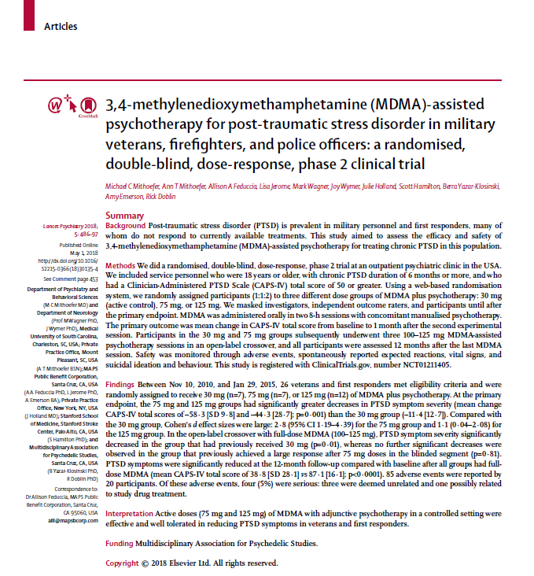

Slide 45
Methods/Background
Randomized, double-blind, dose-response phase 2 clinical trial
Patients with CAPS-IV score of 50+ assigned to 30, 75, or 125 mg MDMA dose
MDMA administered orally in two 8 hr sessions w/ concomitant psychotherapy
Blind broken, patients receiving 30 and 75 mg doses then received three 100-125 mg MDMA-assisted psychotherapy sessions
Parameters measured during, 1 month, and 12 months following MDMA-assisted psychotherapy sessions
Notes:
Clinician-Administered PTSD Scale (CAPS-IV)

Slide 46
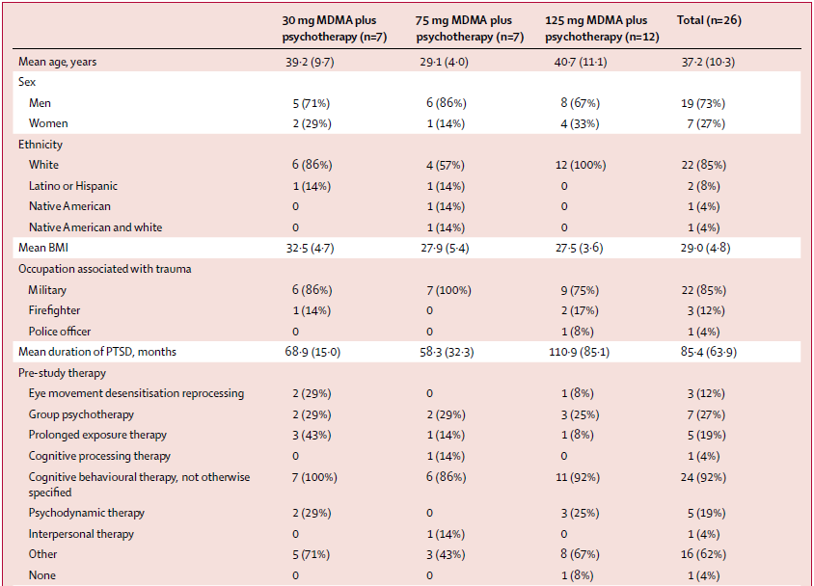
Demographics
Notes:
Most are white male veterans who are treatment resistant

Slide 47
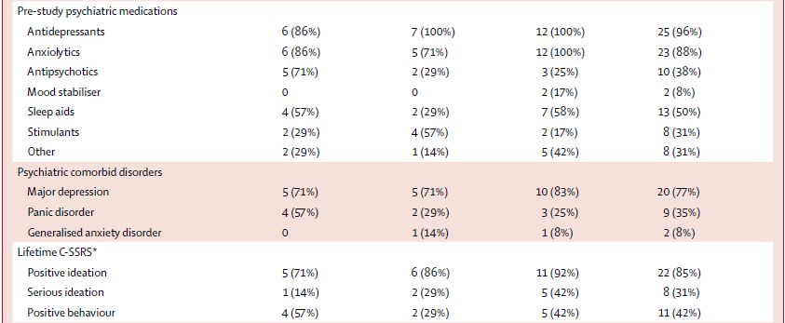
Demographics
Notes:
Most have tried other drug therapies and have a comorbidity as well as suicidal ideation at least once in their life
Columbia Suicide Severity Rating Scale (C-SSRS)

Slide 48
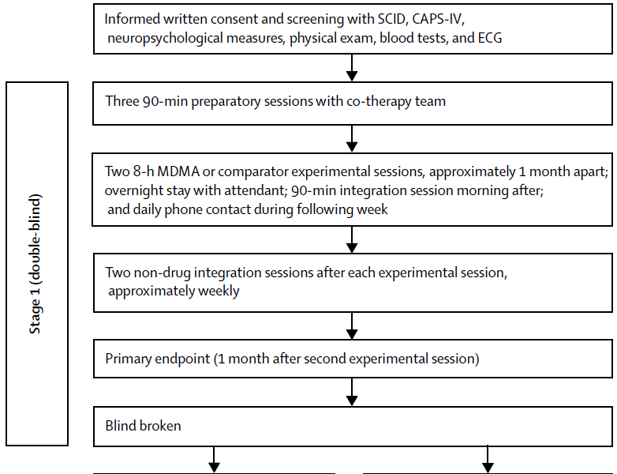
Notes:
Stage 1 double blind pipeline

Slide 49
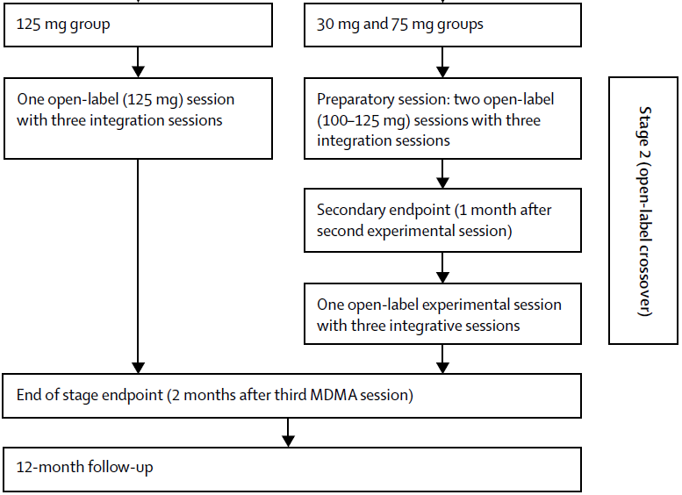
Notes:
Stage 2 open-label crossover (blind-broken) pipeline

Slide 50
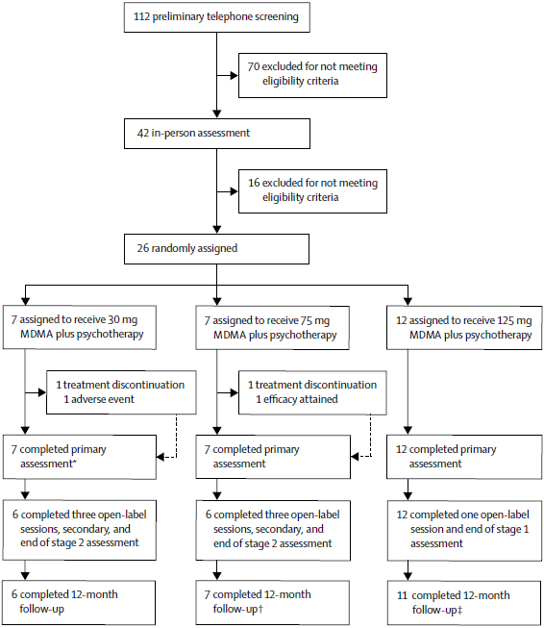
Notes:
Simplified Trial Profile to explain participant distribution and completion data

Slide 51
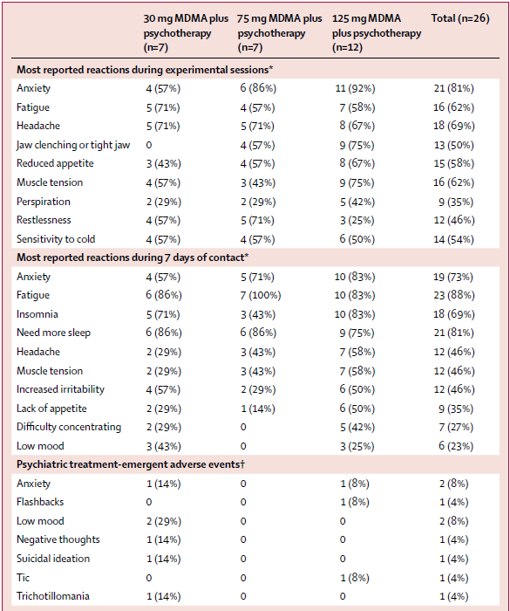
Reactions
Notes:
All the reported side effects/reactions to the drug
85 adverse events were reported by 20 participants. Of these adverse events, four (5%) were serious: three were deemed unrelated and one possibly related to study drug treatment.

Slide 52
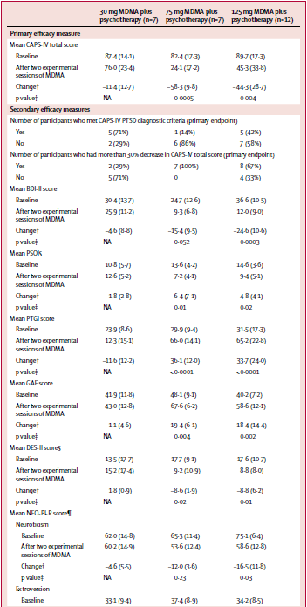
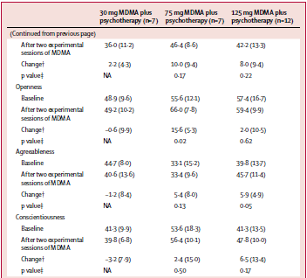
1 Month Follow Up
Notes:
Changes in psychiatric scores one month following MDMA assisted psychotherapy. Many changes are already evident.

Slide 53
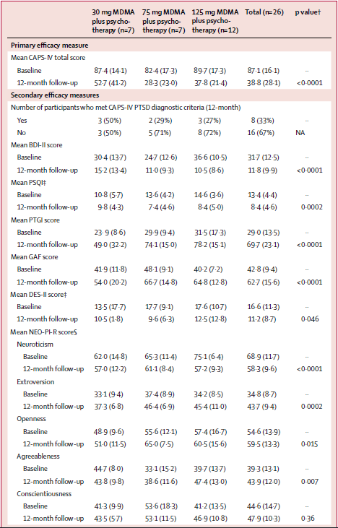
12 Month Follow Up
Notes:
Changes in average psychiatric scores during 12 month follow up. Affect of drug, time, or both?

Slide 54
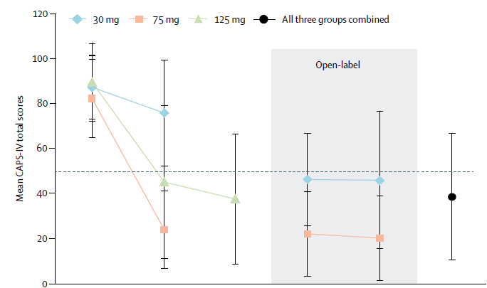
CAPS-IV
Notes:
Clinician-Administered PTSD Scale; overall decrease for all groups combined
All groups see a lower CAPS-IV average score, which is good

Slide 55
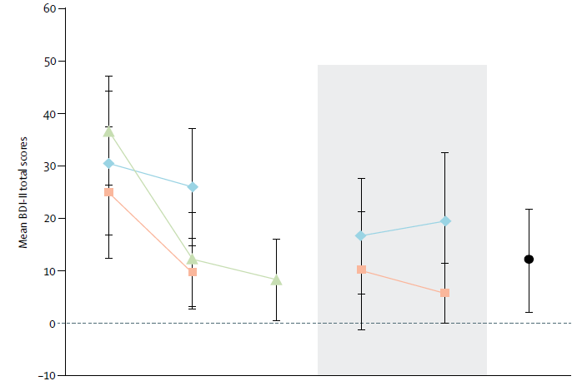
BDI-II
Notes:
Beck Depression Inventory; overall decrease for all groups combined
Almost all groups see a decrease in depression scores, except for the lowest MDMA dose in the open-ended stage 2 trials

Slide 56
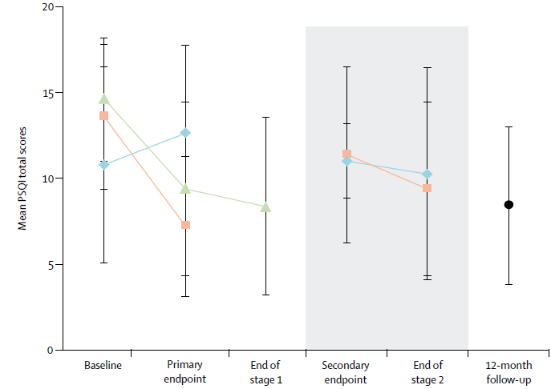
PSQI
Notes:
Pittsburgh Sleep Quality Index; overall improvement for all groups combined
75 and 125 mg MDMA all see improvements in sleep scores, lowest MDMA dose sleep scores worsened in blind phase 1

Slide 57
Discussion/Take Away
Higher controlled doses of MDMA are more effective at decreasing PTSD severity
If initial dose is not enough, subsequent higher dosing can also be effective at decreasing PTSD severity
Many adverse events were reported during MDMA-assisted psychotherapy, so monitoring by a trained professional is vital for treatment tolerance
Both time and drug had a significant effect, but neither a control group (no trauma) nor true placebo (0 mg MDMA) was used. Does this affect the validity of results?

Slide 58
Final Thoughts/Closing Remarks
Anxiety related psychoses like PTSD are often comorbid with other disorders and can be treatment resistant
MDMA & Ketamine are two psychedelic drugs showing promise for PTSD treatment, are fast acting, and should be taken in tandem with closely monitored psychotherapy
Understanding the mechanisms behind these disorders and how drugs affect them is essential for developing effective treatment strategies both at a molecular and global level
Animal models can be the stepping stones for clinical trial by helping to unravel molecular mechanisms at play
Few clinical trial do exist, but are essential for forwarding the field of study on psychedelic assisted psychotherapy for anxiety related conditions

Slide 59
Questions?
Questions?
Questions?
Questions?
Questions?
Questions?
Questions?
Questions?

